Slide 1
HC Research report automation
iResearch
Last update ( 8-11-2009)

Slide 2
Table of contents
Word 2007 add-in
New Report | 4
Insert Paragraph | 5
Insert Table | 6
Insert Chart | 7
Insert Contact Card | 8
Insert Contact Sheet | 9
Insert ( 1 or 2 ) Chart Place Holder | 10
Format (Existing) Table | 11
Embed or Link Excel Selection | 12
Excel 2007 add-in
New iResearch Workbook | 14
Format a range of cells using iResearch Table Look and Feel | 15

Slide 3
Word 2007 add-in

Slide 4
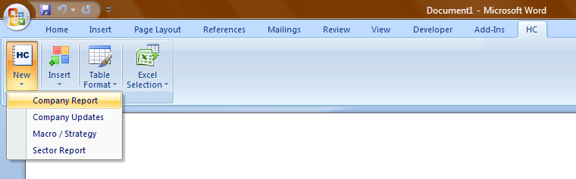

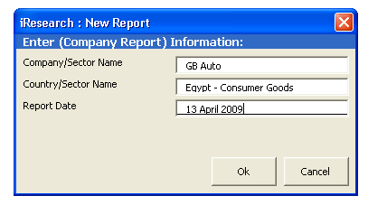
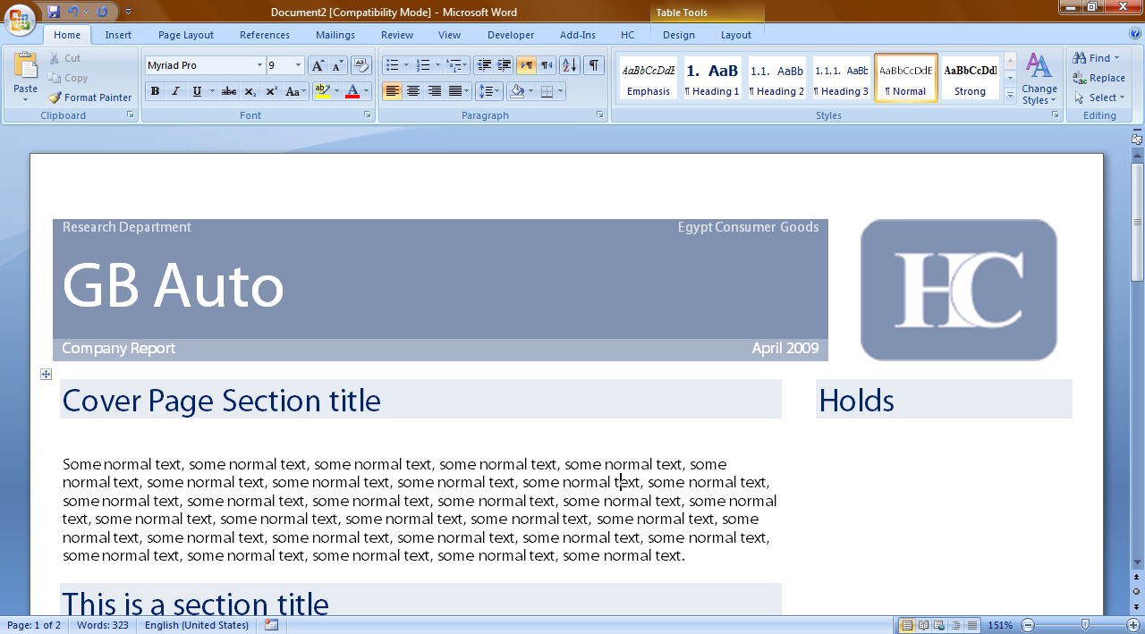
Word 2007 add-in
New Report
1
2
3
4

Slide 5
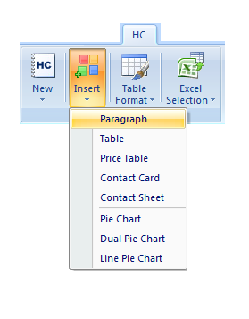
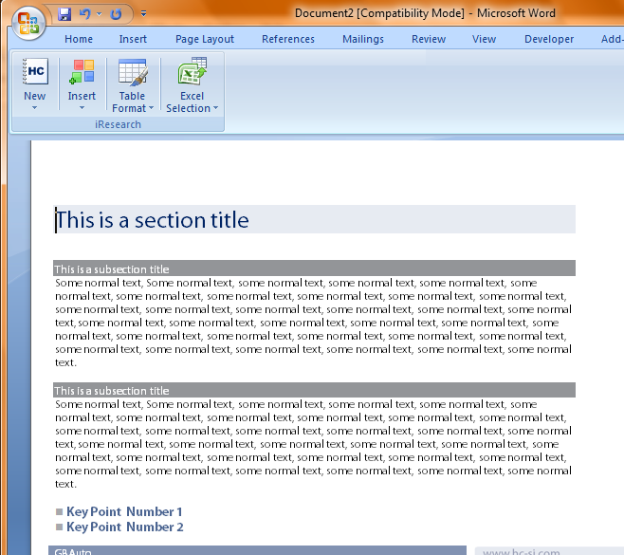
Word 2007 add-in
Insert Paragraph
1
2

Slide 6
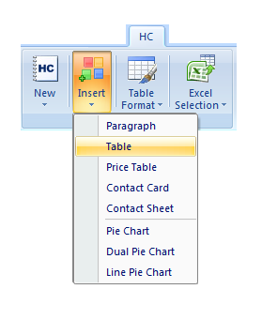
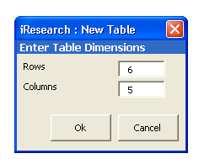
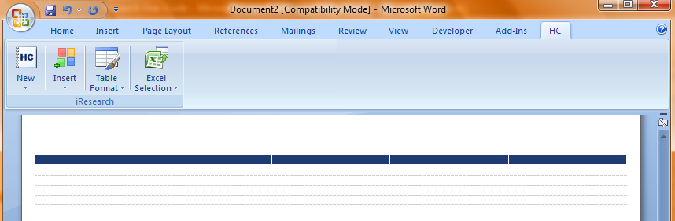
Word 2007 add-in
Insert Table
1
2
3

Slide 7
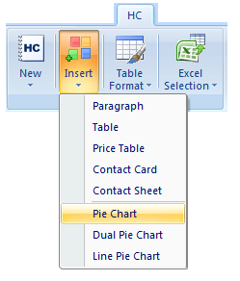
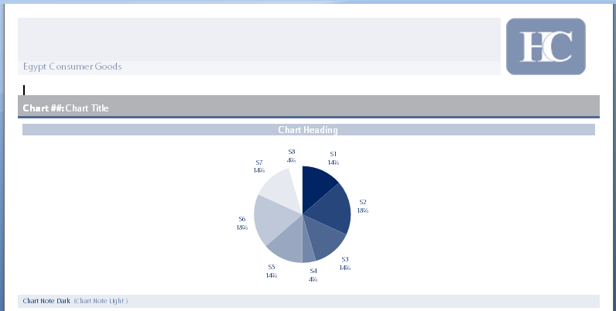
Word 2007 add-in
Insert Chart (Pie/Dual Pie/Line)
1
2

Slide 8
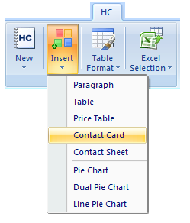
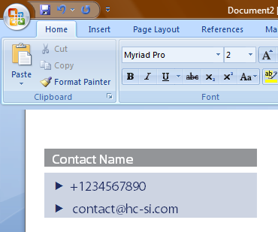
Word 2007 add-in
Insert Contact Card
1
2

Slide 9
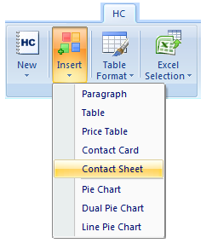
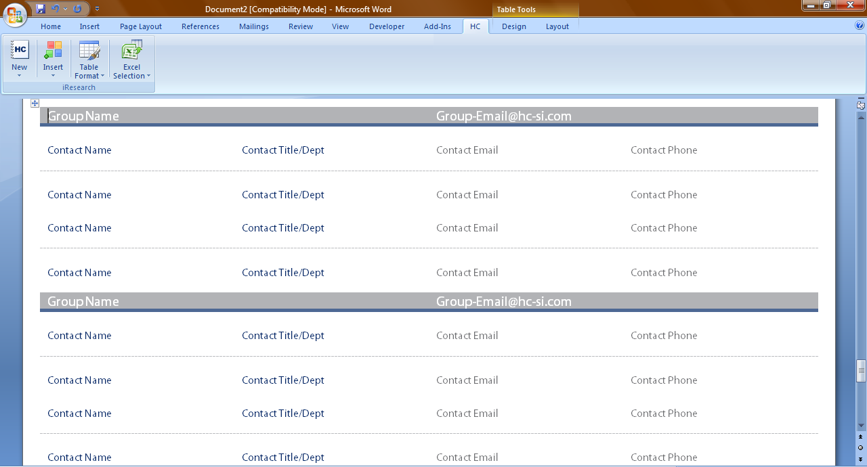
Word 2007 add-in
Insert Contact Sheet
1
2

Slide 10
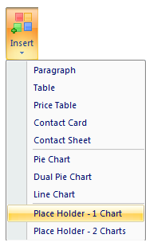
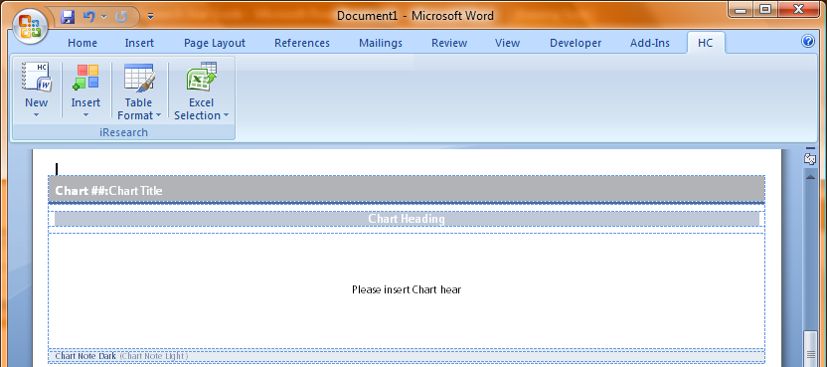
Word 2007 add-in
Insert (1 or 2 ) Chart Place Holder
1
2

Slide 11
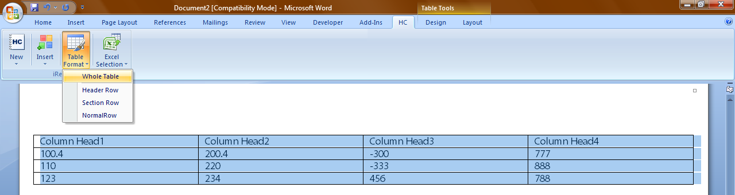
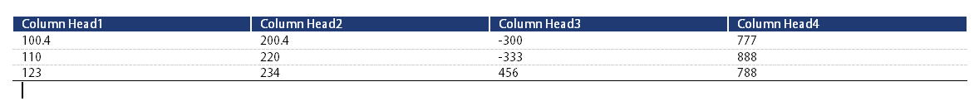
Word 2007 add-in
Format (Existing) Table
1

Slide 12
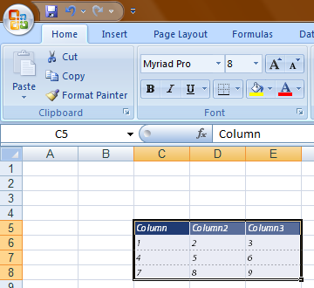
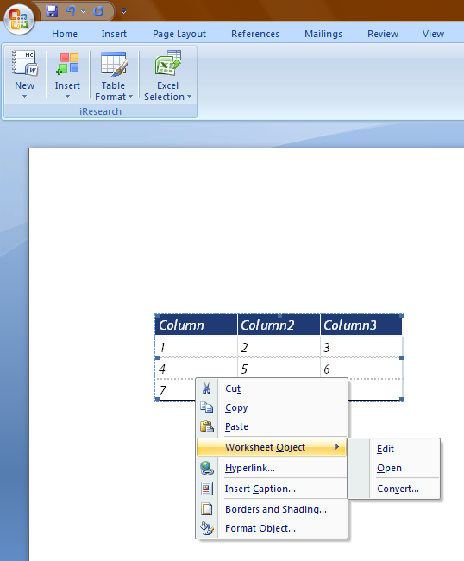
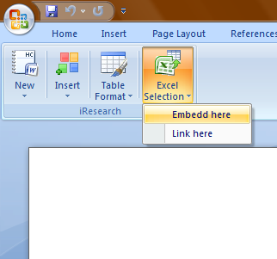
Word 2007 add-in
Embed or Link Excel Selection
Step 1 : Open a saved Excel workbook and select a range of cells
Step 2 : Open a Word document and place the cursor in the insertion place
Step 3 : From HC tab, Select Excel Selection > Embed here or Link Here
Step 4 : To Edit the inserted range, select Worksheet Object > Edit or Open
1
2
4
3

Slide 13
excel 2007 add-in

Slide 14
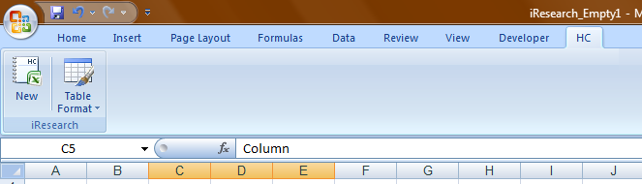
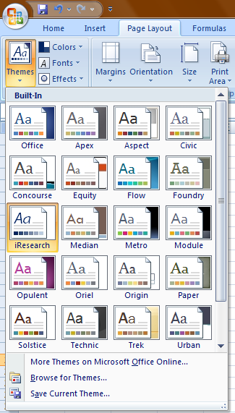
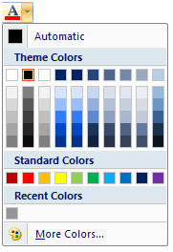
excel add-in
New iResearch Workbook
To create an Excel workbook based on iResearch Colors, click on the New button under HC Tab
This will automatically adjust the new workbook theme (colors and fonts)

Slide 15
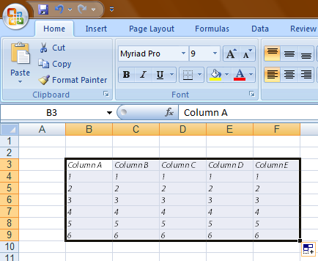
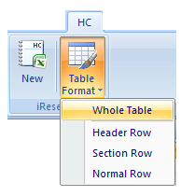
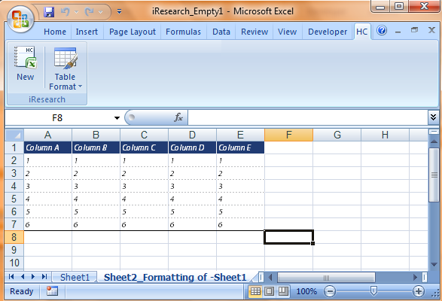
excel add-in
Format a range of cells using iResearch Table Look and Feel
Select a range of cells
From Office Ribbon, switch to HC Tab and Click on Table Format > Whole Table
A new sheet will be created and the iResearch look and feel will be applied on the new sheet
1
2
3

